Slide 1
STS Global Test Data Management
NI STS Test Program Development Best Practice
Matthew Roberts
NI Senior Field Applications Engineer

Slide 2
Overview
STS Global Test Data Management
Problem Statement (why is this needed?)
Overview of TSM Data Access Technique
Workflows
Adding Global Test Data to Existing Project
Creating A New Property
Using Global Test Data Properties in Code Modules
Taking this concept to the next level!

Slide 3
Problem Statement
STS Global Test Data Management
Why is this needed?
Pros/Cons

Slide 4
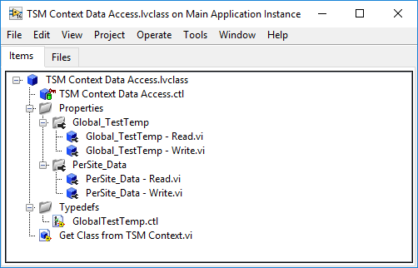
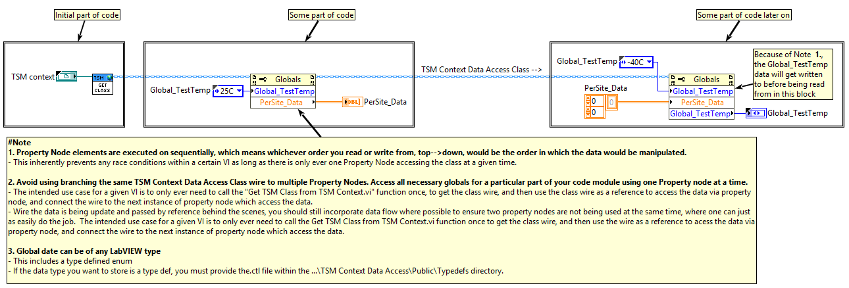
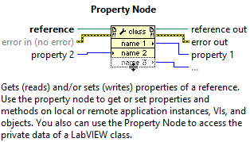
Overview of TSM Data Access Technique
STS Global Test Data Management
Convenient Test Program Data Storage, Access, & Management
Uses Semiconductor Module Context & corresponding API as the means for memory storage
Global & Per-Site Capable
Extracts data types & sites management away from the users
Based on a flat LabVIEW Class with a pre-defined set of Properties
Read & Write accessor functions created for each individual data item being stored
Only two LabVIEW nodes needed during test program development
Get Class.vi
Property Nodes
Used to invoke pre-defined read/write accessor functions for a given data item
Scalable to add as many data items as needed throughout the development process

Slide 5
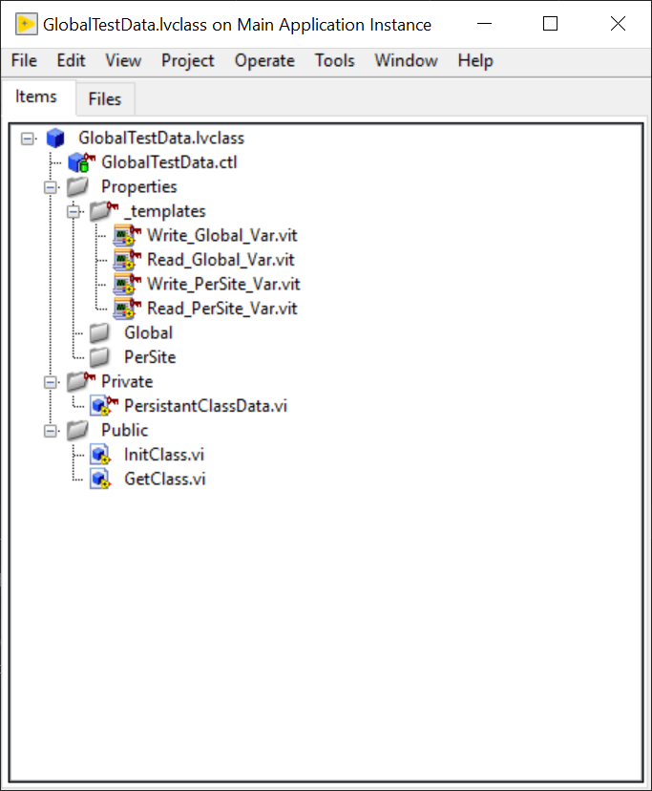
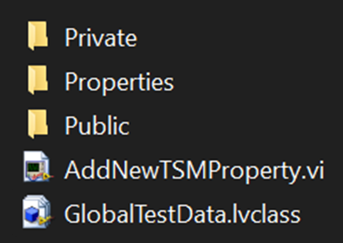
Global Test Data Template Files
STS Global Test Data Management
Includes:
GlobalTestData LabVIEW class
Property VI Templates - Global & PerSite
AddNewTSMPropery.vi - scripts new properties and adds them to the GlobalTestData class automatically based on the name and scope specified by front panel controls.
Note: these templates files can but should not be modified.

Slide 6
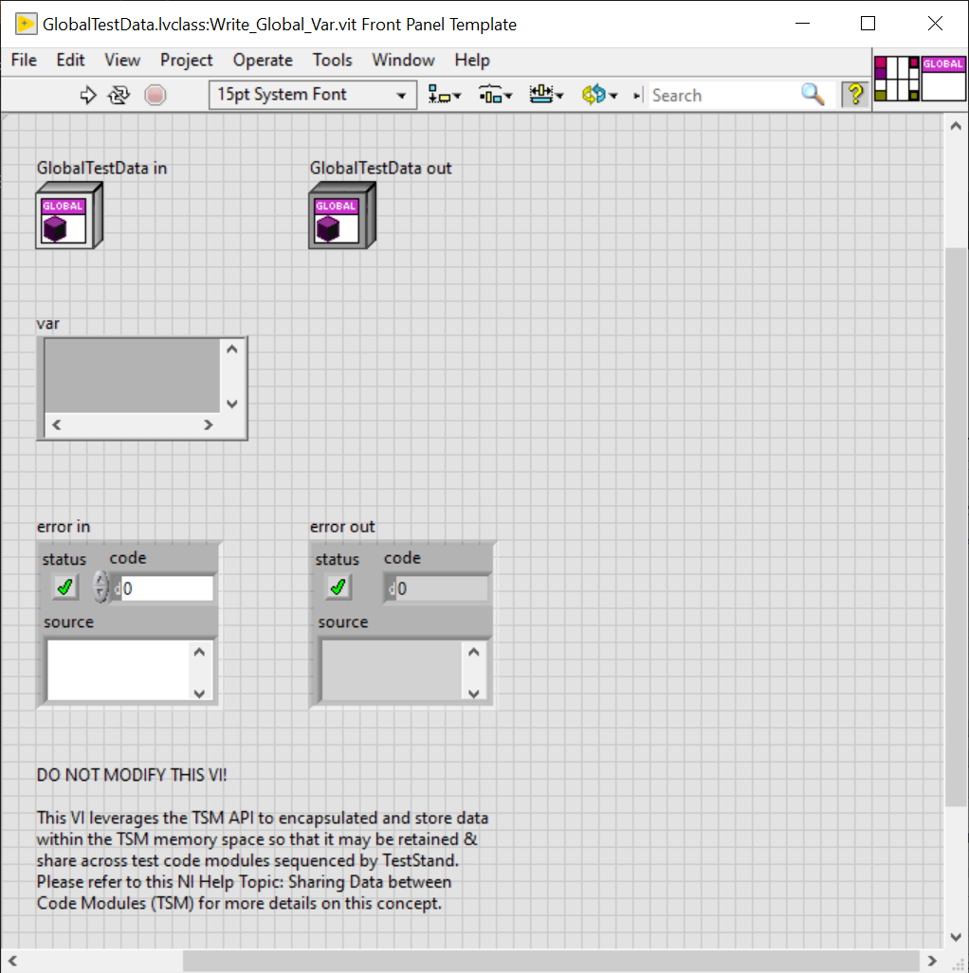
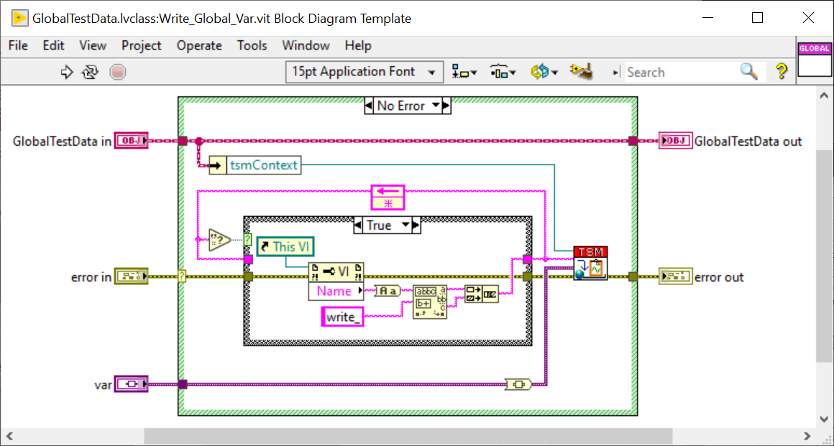
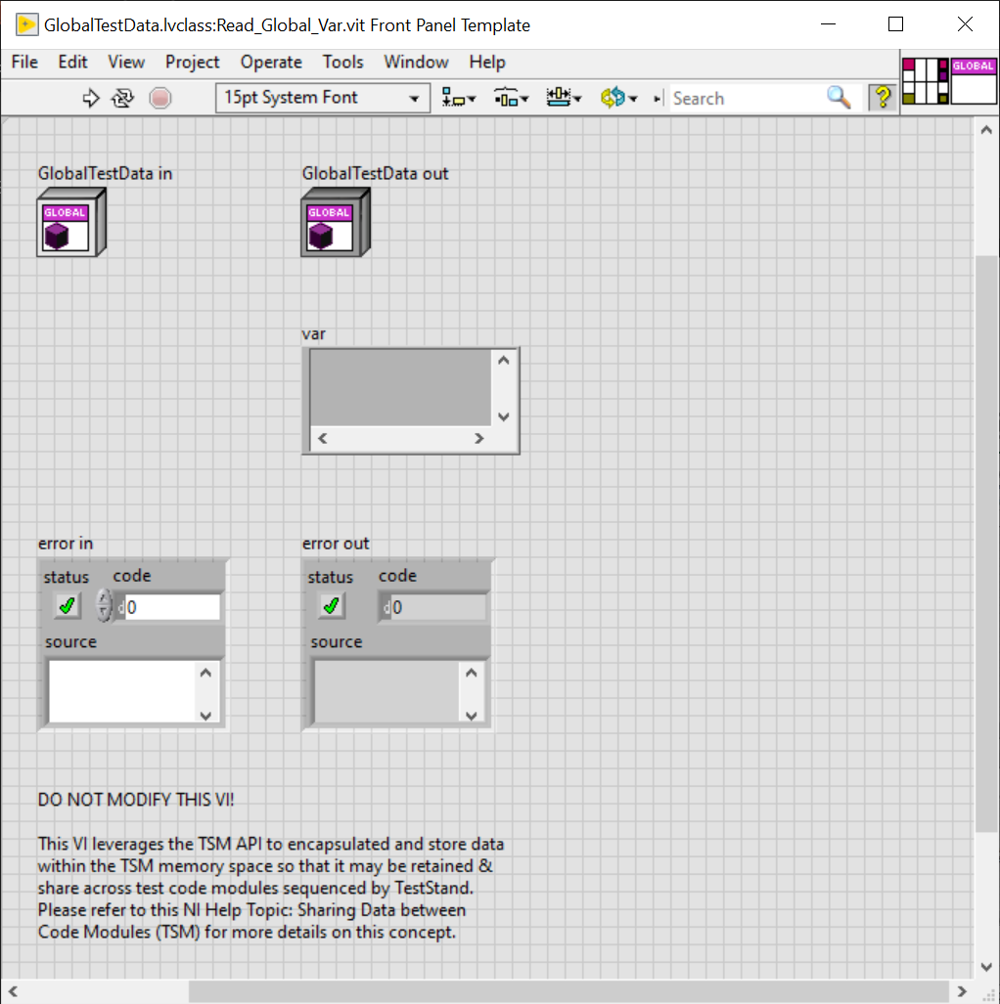
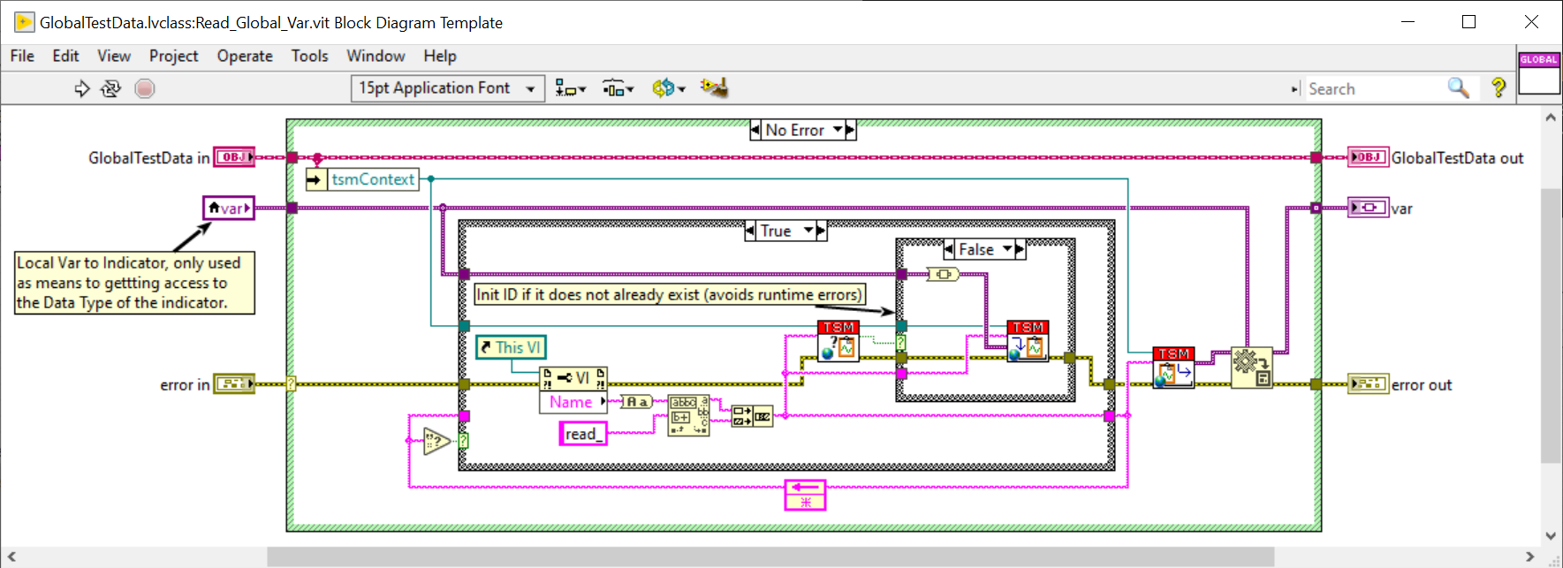
Read/Write Template VI - Global
STS Global Test Data Management

Slide 7
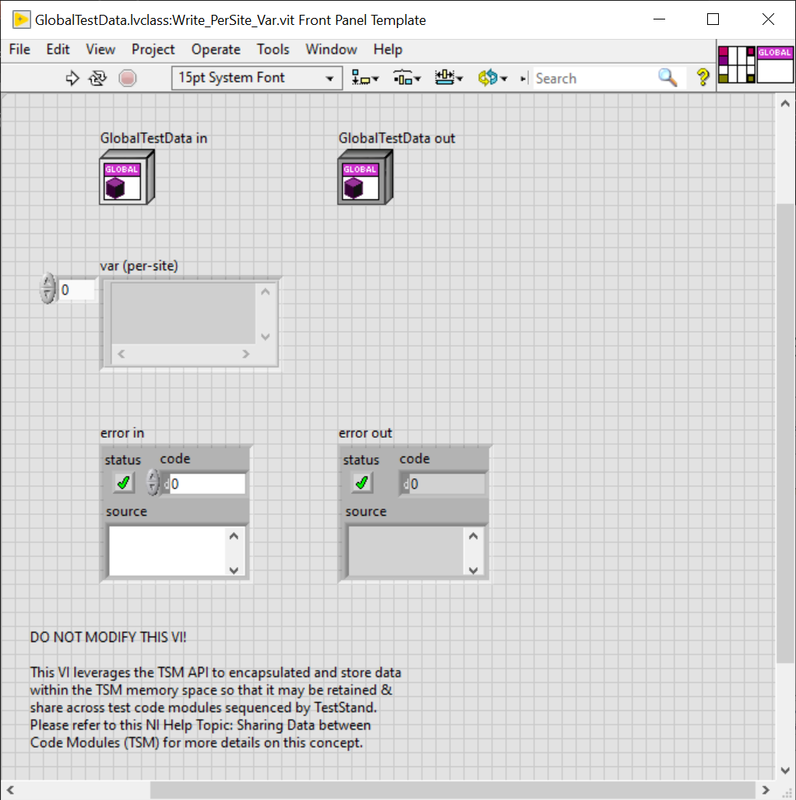
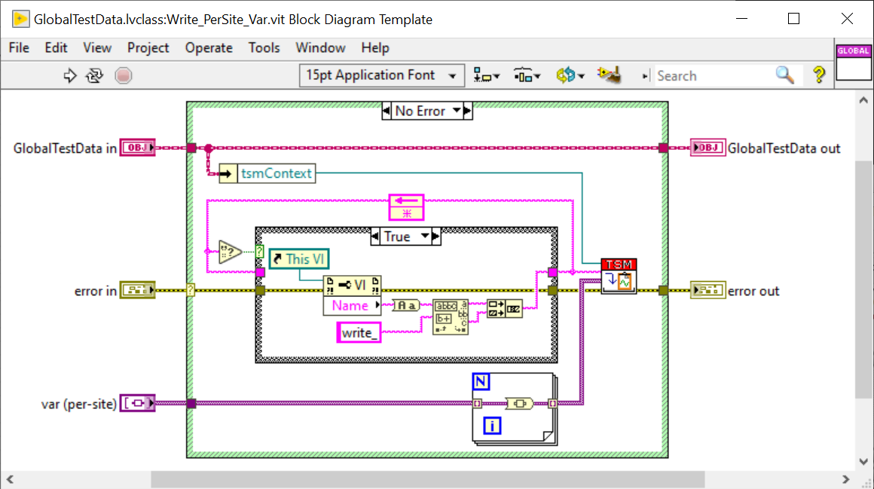
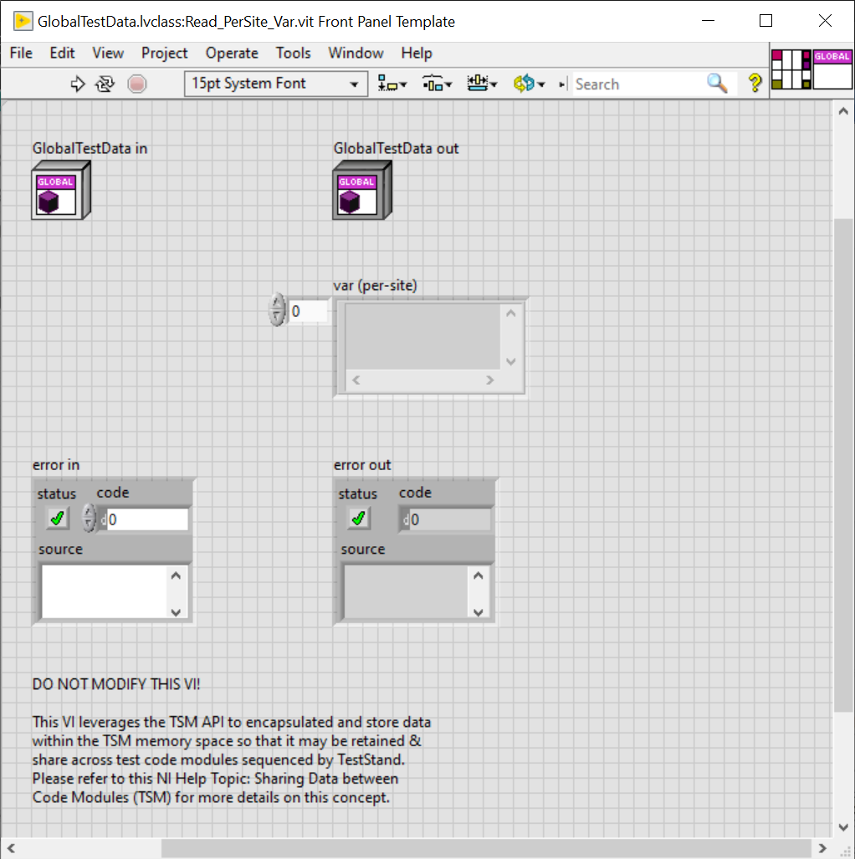
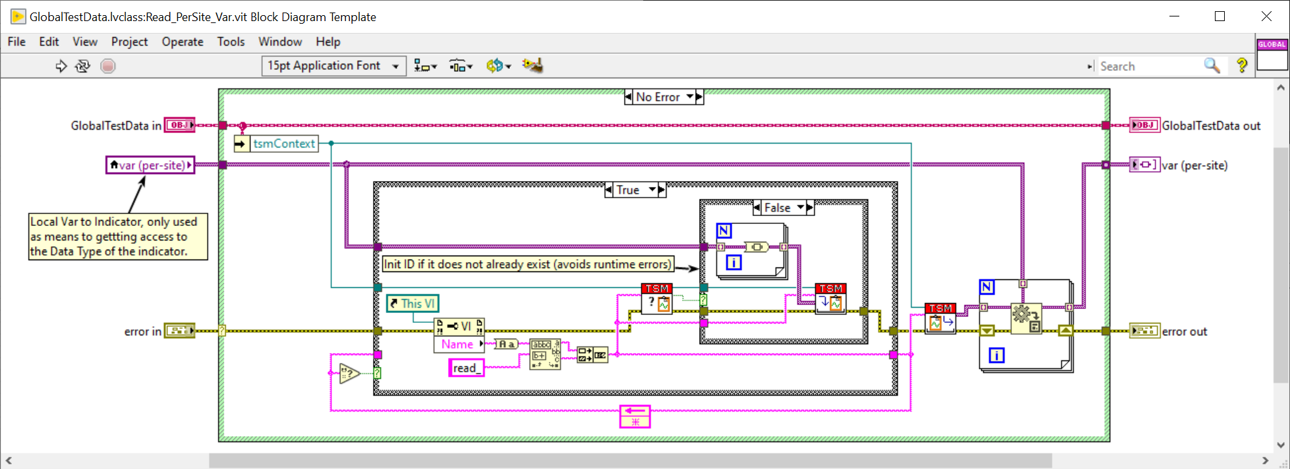
Read/Write Template VI - PerSite
STS Global Test Data Management

Slide 8
Workflow – Adding Global Test Data to Existing Project
STS Global Test Data Management
Make a copy of Global Test Data template files and place them in your test program’s source directory, under Code Modules/Common
Ensure the Common/Global Test Data is also added to the LabVIEW project
Define & add new application specific properties to the Global Test Data class
Create both a Read & Write VI for each new property.
Refer to proceeding slides labeled: “Workflow – Creating A New Property slides”
Repeat as needed to scale during test program development

Slide 9
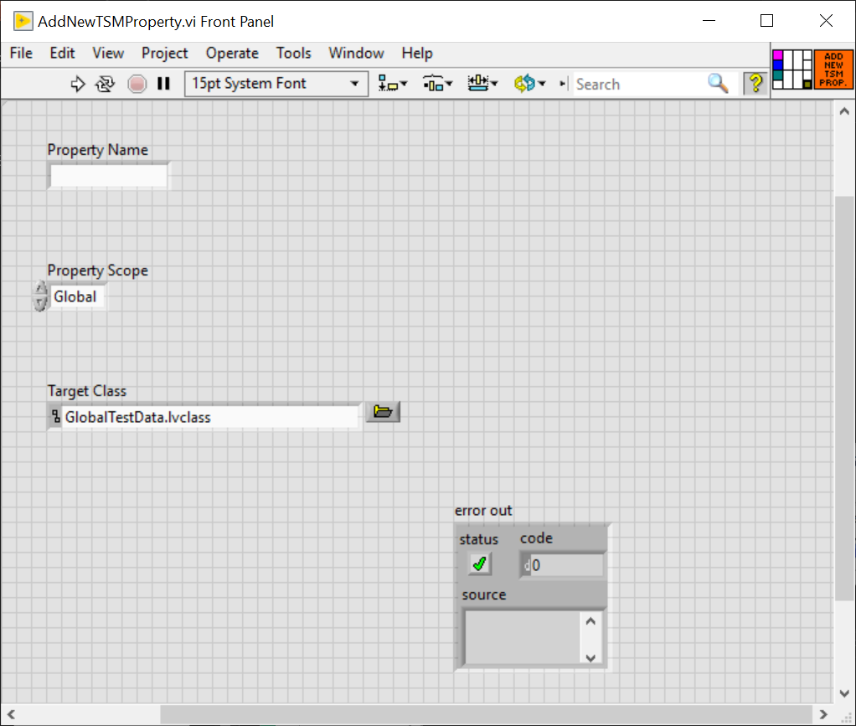
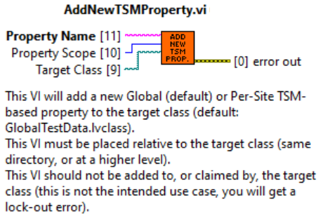
Workflow – Creating A New Property (Scripted Method)
STS Global Test Data Management
Change Data Type of Control on Write function, and Indicator on Read function
Update the Connector Pane of both functions. Example:

Slide 10
Workflow – Creating A New Property (Manual Method)
STS Global Test Data Management
Change Data Type of Control on Write function, and Indicator on Read function
Update the Connector Pane of both functions. Example:

Slide 11
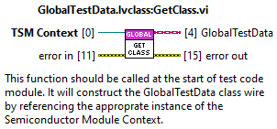
Workflow – Using Global Test Data Properties in Code Modules
STS Global Test Data Management
Accessing Data During Code Module Development
ProcessSetup
Drop down the GlobalTestData.lvclass:Get Class.vi onto the block diagram of your code module and wire the Semiconductor Module context to its top input terminal (TSM Context).
Drop down a LabVIEW Property Node (any type) and wire the GlobalTestData class wire from the Get Class from TSM Context.vi’s output terminal to the Property Node’s input terminal.
Click to select the items to access within the property node and drag the bottom of the property node to expand out the number of items to be accessed.
Note: right clicking the item within the property node will allow you to change whether to read or right to that property, it will read by default unless changed. It will also give you an option to open the accessor function if it needs to be reviewed or modified.
Notes:
#Notes
1. Property Node elements are executed on sequentially, which means whichever order you read or write from, top-->down, would be the order in which the data would be manipulated.
- This inherently prevents any race conditions within a certain VI as long as there is only ever one Property Node accessing the class at a given time.
2. Avoid using branching the same TSM Context Data Access Class wire to multiple Property Nodes. Access all necessary globals for a particular part of your code module using one Property node at a time.
- The intended use case for a given VI is to only ever need to call the "Get TSM Class from TSM Context.vi" function once, to get the class wire, and then use the class wire as a reference to access the data via property node, and connect the wire to the next instance of property node which access the data.
- Wire the data is being update and passed by reference behind the scenes, you should still incorporate data flow where possible to ensure two property nodes are not being used at the same time, where one can just as easily do the job. The intended use case for a given VI is to only ever need to call the Get TSM Class from TSM Context.vi function once to get the class wire, and then use the wire as a reference to acess the data via property node, and connect the wire to the next instance of property node which access the data.
3. Global date can be of any LabVIEW type
- This includes a type defined enum
- If the data type you want to store is a type def, you must provide the.ctl file within the ...\TSM Context Data Access\Public\Typedefs directory.

Slide 12
Taking this concept to the next level!
STS Global Test Data Management

